Slide 1
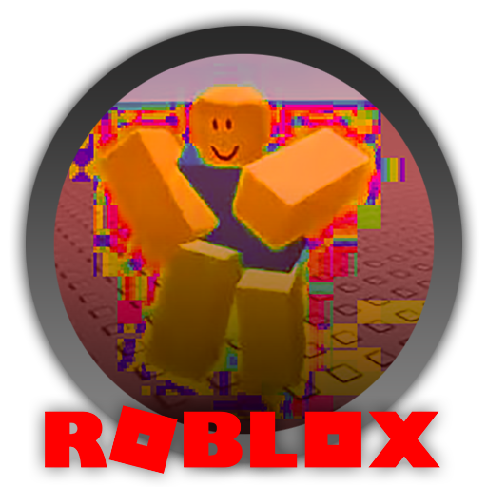
IST 623 Andrea Burgess Kelsey Wenzel Andrew Thomas Joseph Maugeri
This Photo by Unknown Author is licensed under CC BY-NC-ND
Notes:
Slide 1: Introduction to the presentation topic ~ 10 seconds Roblox platform is our groups topic. There have been pervasive security concerns across the life of the platform.
The Platform has done tons in it's lifetime (since 2006) to add more ways to create, but have they appropriately protected users?
Roblox has experienced rapid commercialization and expansion at the hands of the pandemic.
This presentation will cover:
Security incidents & Privacy Concerns / timeline
Current Content moderation and age restrictions
Recommendations for staying safe on Roblox and can it be safe for kids?
Summary/Conclusions

Slide 2
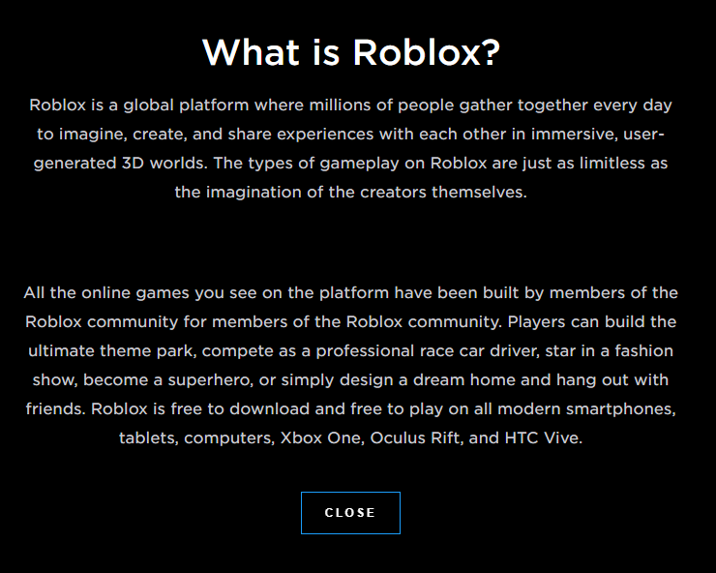

(…Yes, anD:)
Roblox’s Message to Parents…
A Content creation and sharing platform
A Social networking hub
A 200 mil. + user base
An education tool
A programming environment
A public traded company
A child’s first time using the internet unsupervised
Notes:
~ Right, playing off the last slide, Roblox will tell you what it thinks it is. Here's what we say it is in the form of a slide. This slide is a thoughtful slide to point at the overlooked multi-use cases of Roblox for cybercriminals. This will set up the conversation on the topic of the varied security threats. ~ 25 seconds will address the questions: Possibly with engaged parent controls
Increased monitoring of chats, game creations, and friending
Parent controls need to address sexual content
Games need to be available only after a vetting process

Slide 3
Roblox's Experience Guidelines
IS ROBLOX SAFE FOR KIDS?
Everyone Ages 10+ Rating
Terms and Agreements require parental consent for users under 18
Users under age 13 are denoted on usernames
Underage users may see inappropriate content despite enabled parental controls
Parents may review a history log of their child's activity
Parents and users may block members
Chat phrases are moderated for young users
Users who are not friends with young users cannot talk to them
All users are searchable
Friended users will show detailed activity
Unfriended users will show undetailed activity
All Ages
Infrequent Mild Violence
Light Unrealistic Blood
9+
Mild Violence
Light Unrealistic Blood
13+
Frequent Moderate Violence
Realistic Blood
Notes:
Great slide to follow up the security incident timeline one, we should note the general vagueness with which roblox exercises these terms. ~30-45 seconds

Slide 4
"content" is Made by USERS
Roblox sells itself constantly on the “limitless possibilities” that exist for users on the platform, but do we want all of those possibilities to occur? No.
This is due to the nature in which the platform generates content, through its users
Users with popular places are “paid” with in game currency Robux for their content by other users/ the system.
While users still make a majority of the content (games, items, groups) the commercial market has begun to creep because of the surge in popularity
The creation of content by users on the platform is what enables many attackers to create ways to reach end users.
Notes:
Definitely reading the bullets on this slide will get us through it, no real need to ad lib here. This is the crux of the "large attack surface" that roblox has created, and allowed to expand.

Slide 5

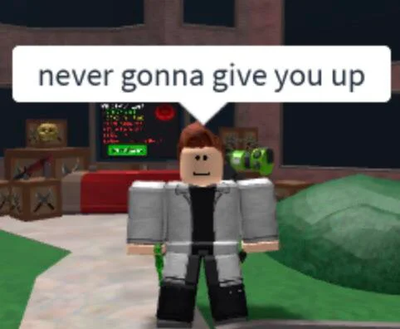

"content" is targeted
On the platform today content creators can make money by creating popular items and places.
The most popular content is usually related to pop culture in some way
Memes
Current shows
Music
Fashion trends
Notes:
Definitely reading the bullets on this slide will get us through it, no real need to ad lib here. This is the crux of the "large attack surface" that roblox has created, and allowed to expand. Ads pay money to pick the age range. So its money over everything really.

Slide 6
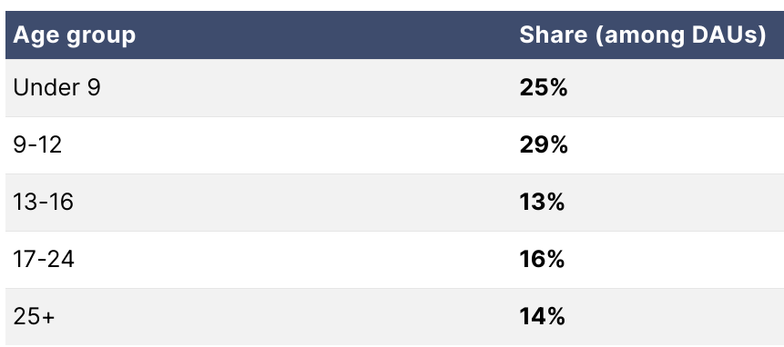
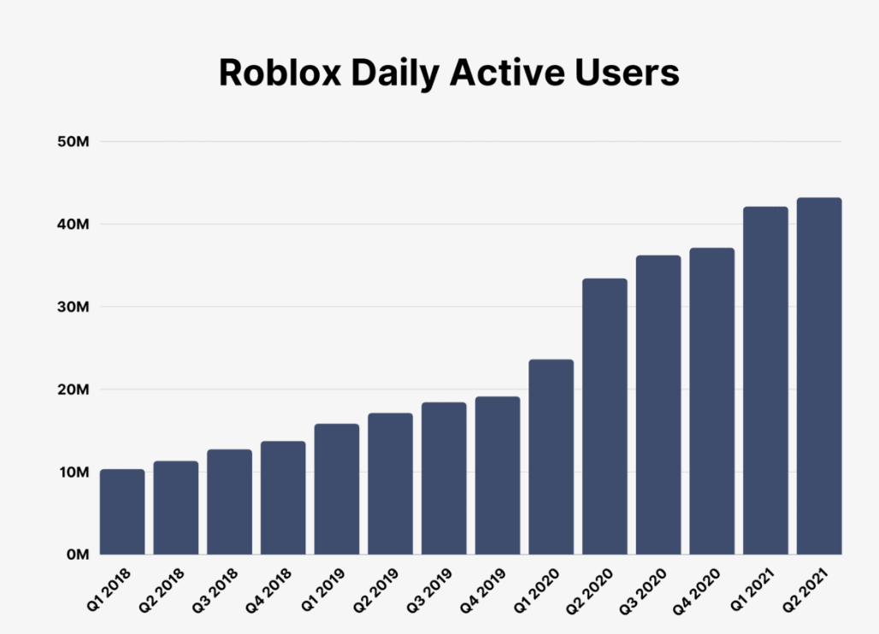
Roblox history, current audience and rapid growth among young users
2004
Name changed to Roblox
September 1st, 2006
Official Roblox Launch
2005
DynaBlocks is created
May 14th, 2007
Roblox points are replaced with Robux currency
August 16th, 2007
Exclusive Builders Club introduced
August 1st, 2011
First Roblox Convention is held in San Francisco, CA
July 14th, 2012
Roblox Game Conference is held in Santa Clara, CA
2013
Roblox hosts three Roblox BLOXcon events in DC, Chicago, and London
April 1st, 2012
Roblox website is compromised in an April Fools security incident
October 28th, 2021
Website goes offline for three days – users experience password errors and 2-step verification issues upon return
April 14th, 2022
Major website disruptions
May 4th, 2022
Server error restricts users from website – rumors of hacked server circulate
December 31st, 2021
Roblox Corporation employs 1,600 people
July 2016
Unauthorized group hacks Roblox's Customer Service Admin Panel
January 8th-9th, 2019
Multiple games were hacked and set to private status, restricting users
November 22nd, 2022
Chrome extension error deleted many users' items and Robux
Notes:
Great slide that may get at the priorities of Roblox, and how it has been able to go overlooked for a long time. ~ 1-2 minutes

Slide 7
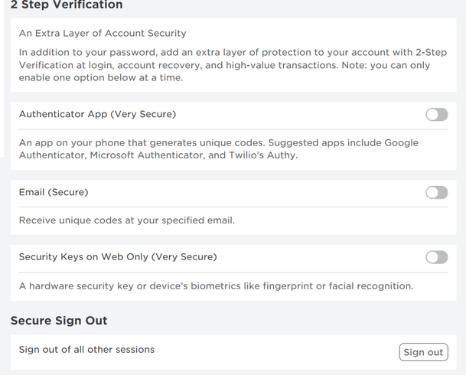
Authentication Security Features
Roblox has developed increased layers of account level security over time
None of these extra features are required of an account
Bots (malicious accounts) can be easily created via script, bot will then have access to the users on the platform, and the creation environment Roblox Studio.
From there the bot can log on to a server and run injector scripts. Success is usually determined by the skill of the developer of the game they are targeting.

Slide 8
Security incidents & Privacy Concerns / timeline
Notes:
Fantastic slide to break up the flow and let everyone know the intro material is pretty much over. I'd milk it a little bit to give everyone a pause and let them prepare to absorb the next slide better. ~ 15-19 seconds

Slide 9
Security incidents & Privacy Concerns / timeline
Roblox profiles hacked to display support for Donald Trump June 2020
Dynamic HTML disabled to stop "place stealing" attacks Jan 8 2008
Roblox Summer Games are shut down due to exploiters
Unknown person bypasses Roblox ASLR, allowing for easy "injector creation" Jun 2016
Fake Robux Generator Scams appear in 2014, through phishing attacks
Roblox - WINDOWS released September 1, 2006
Roblox – IOS Beta released January 6, 2012
Roblox -Android released July 16, 2014
Roblox - Xbox One released November 20, 2015
Exploiters insert explicit models and target young children's avatars July 2018
Notes:
On the screen are a few examples of the nature of roblox's security incidents ( of which there are many ) as roblox diversified. In many cases the extent of the information on these incidents was limited, but the general nature in which hackers take advantage of roblox are through the loose bounds on "creative freedom" on the platform. These attacks occurred in varying amounts on the different platforms, with PC being the predominant environment due to the coding interface that roblox offers every user. Think of it like art, if its famous art, its imitated.

Slide 10
General Exploitation
A game instance operates an environment on a client-server basis
Users have access to many how-to guides on the web ranging from bypassing chat filters to creating and deploying their own client-side hacks on games.
Over time Roblox has done some updates in response to various exploits, but for the most part they are always one step behind the cyber attackers.
There are online forums dedicated to exploitation – such as V3rmillion, which contain explicit content pertaining largely to Roblox.
Notes:
Read slide. First bullet – explain: a wide variety of things can happen, but in terms of actual game mechanic exploitation, Users are able to deploy a variety of "hacks" deploy the coding interface with their own scripts written in lua.

Slide 11
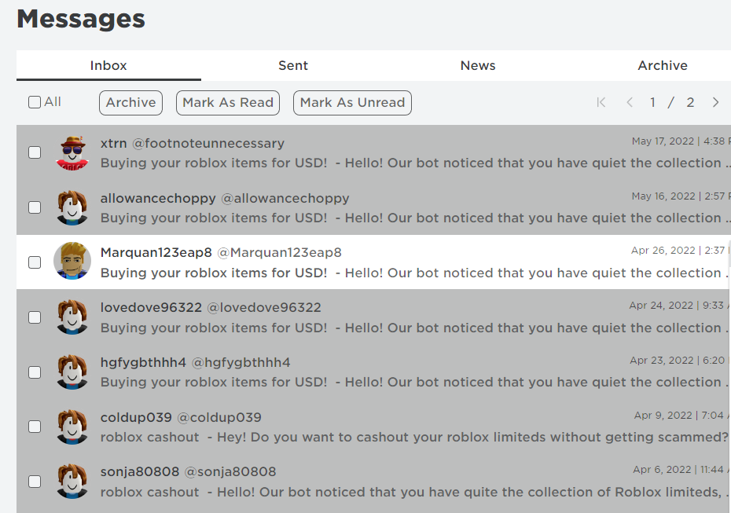
Example of Recent bot Attacks
A more experienced user may not blink twice at these pm's,
This is one of many "bot" scams that appeared first in 2014 as "Robux" generators.
This one in particular focused on an attribute of the user that is available on their public profile
This scam is an example of usage of a "bot" for credential/item stealing one, but many others can be "created" in ways that spoof actual purchasable content.
Notes:
Read the slide

Slide 12
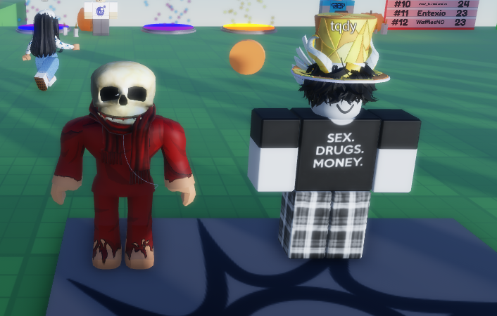
Bypassing Moderating features
It's quite easy to get around these safety features. Explicit content such as t-shirts can be found in the game.
There is so much content it is difficult to discover all explicit content.
However, Roblox could do more to section it's younger user base away from these "bypasses"
Notes:
Read the slide,

Slide 13
Where Roblox Security has Failed
Content creators can freely embed links to other social platforms (twitter, facebook, discord)
Roblox is available on several systems which are not operated securely
Legitimate source code, which was serviced by Synapse ™ on the Roblox Android app was able to be edited in 2022. (Lapienyte, J. 2022)
Roblox uses several Third-parties to handle security on variable operating requirements across the globe, with Android app being especially weak. Mikalauskas, E. (2022)
Roblox used MD5 and SHA1 - weak hashing algorithms for encrypting user data
This data was also stored in SQLite databases – susceptible to SQL injection attacks.
Roblox Android app uses fixed API key, that makes it more vulnerable for manipulation and querying of data by attackers.
Notes:
After reading this slide Andrew will take it from here

Slide 14
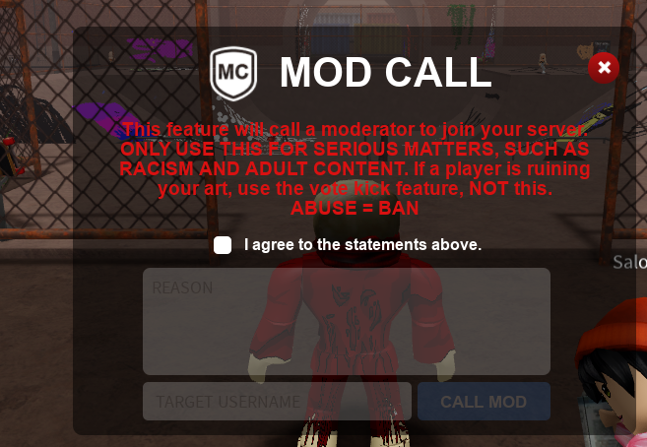
Feudal Security on the Platform
Many developers are forced to implement their own security features in their games.
Shown left are creator-based moderation of a server, attempting to make up for the gaps that Roblox has
The need for creators to create and secure their own games ups the variability of what appears to be "safe" on the platform.
This may make scammer/hacker attempts more "plausible" to inexperienced users

Slide 15

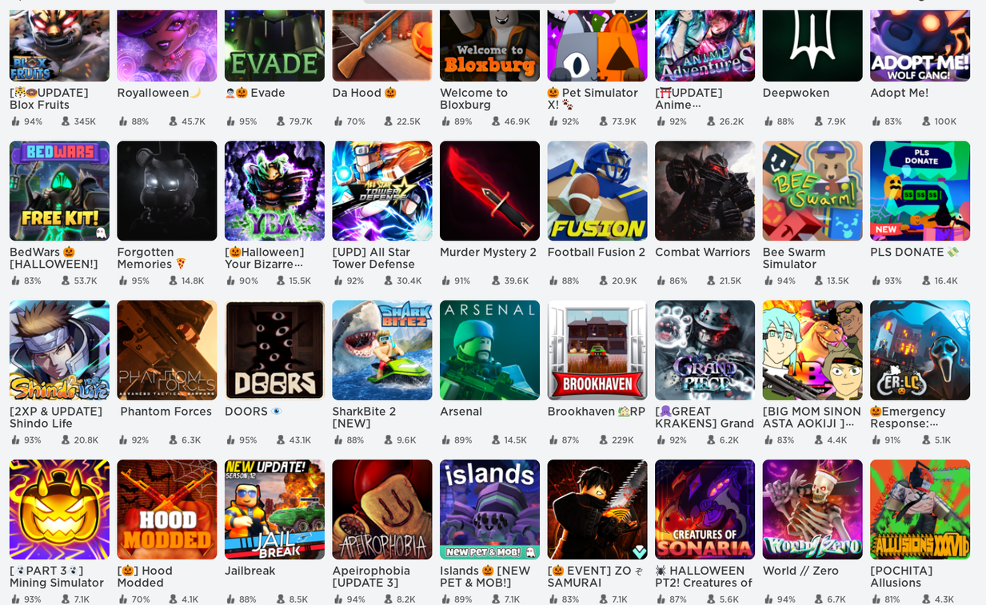
Cyber attacks can take many forms
With continuous content creation, a widespread variety of privacy and security concerns proliferate on the platform:
Low skill level attacks - seeking items/accounts causing general mischief
There are several moderate attacks - seeking personal/financial information or disablement of particular content portions of the platform
There are attacks leveraged at Roblox itself due to it's operational structure and spread across the globe (the differences in administration create weaknesses)
The most severe attacks go beyond these and directly prey upon person (often a child) behind an account seeking to cause physical harm to the person.

Slide 16
Enablement of Exploitation
Ultimately, the warning signs were present in terms of mounting threats and privacy concerns due to scale. In one instance a 10 y/o girl was “hired” by multiple +18 users/developers in 2020. Then in 2021 she was bribed with Robux in game in exchange for explicit content off Roblox (snapchat, discord, etc.). Her abusers manipulated her and ultimately caused severe trauma to the young girl. She attempted her life multiple times and withdrew from school by age 13.
Roblox was recently named in a lawsuit alongside several other platforms for knowledgably allowing these interactions on their platform.

Slide 17
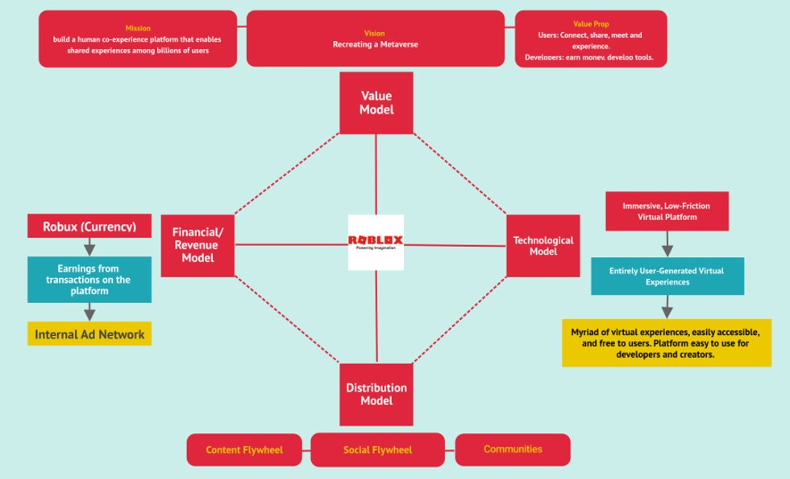
Roblox Business Model
Roblox’s business model is focused on generating influx of users and content.
from Roblox Business Model: Monetizing The Metaverse - FourWeekMBA
Notes:
ALL ABOUT THE MONEY. Not a traditional model traditional organizational structures are hierarchical with a top-down power structure similar to a pyramid.
Roblox structure allows non-management employees to make decisions and determines what projects to work on

Slide 18

Roblox’s Response
For most incidents, Roblox disclaims out of responsibility citing their Privacy Policy and what content they are responsible for on their app
Roblox cites no responsibility for links found on games in their platform
Recently Roblox has filed court actions against some users who violated their ToS, gaining a court order to keep a malicious YouTuber and some followers off the app.

Slide 19
Roblox Privacy Policy
Roblox cites on page 25 of the privacy policy (14.2): "These providers may operate or support certain functions of the Service. Below is an illustrative list of functions for which we may use third party service providers and the names of the providers we may use to perform these functions:"
Account Integrity and Security (e.g.,Veriff, Arkose Labs);
Analytics services (e.g., Google LLC);
User Acquisition services (e.g.,AppsFlyer);
Community filtering and moderation services (e.g., CommunitySift);
Customer support services (e.g.,Zendesk);
Surveys and promotions (e.g., Reach3);
Notes:
Basically hey its not our fault

Slide 20
Other PlatForms
Minecraft
Continues to diversify content and create "apps" like Roblox by a team of professional developers and content creators
All modifications must pass company's quality standards
Upfront cost
Steam
Hosts many games that are created by official developers
Storefront to buy games, app to download and organize game and community features
There are age restrictions on certain content pages, but can be easily bypassed
Facebook
A social networking website with parental controls over kids
2 step verification mandatory for high-risk accounts, and a larger security force
Much more public attention
Notes:
Minecraft – They both are sandbox video games where players can freely explore and create worlds, 140 million monthly active users. Minecraft is paid game, where as Roblox is free to start. Both allow in-game purchases.
Steam – community portal where you can connect with friends to see what they're playing, share screenshots & videos, play cooperative and competitive multiplayer games
Facebook Kids Messenger, Facebook in general

Slide 21
Security Recommendations
Require 2-factor authentication. This could limit the creation of bots, and secure high-risk profiles.
Roblox should attempt to centralize the resources and practices between their multi-console platform
Separate login for parental controls, with more discrete controls over child interactions.
Fully segment or create a separate site for users under a specific age.
If content and security filters cannot be appropriately implemented, you can't place trust in the user on this application.
Notes:
Dedicated IT team/department? Game approval?
Compare separate login to parental facebook messenger login

Slide 22

Summary/Conclusions
While Roblox has some safeguards in place, it is ultimately not safe for all users when it comes to security and privacy. Parents must be fully involved and vigilant to ensure that their children are acting as responsible, safe digital citizens.
Roblox Corporation cannot continue in good faith with the current security and privacy settings. Games need to be vetted, content needs to be reviewed, and strict two-step verification processes need to be in place. This would ensure the all users, and especially the youngest users, may enjoy Roblox as a safe form of entertainment.

Slide 23
References
Lapienytė, J. (2022, May 12). Hackers exploit Roblox’s scripting engine to install trojan. Retrieved November 10, 2022, from https://cybernews.com/news/hackers-exploit-robloxs-scripting-engine-to-install-trojan/
Mikalauskas, E. (2022, May 13). Is Roblox Secure? static analysis reveals subpar security practices on ... Retrieved November 10, 2022, from https://cybernews.com/security/is-roblox-secure-static-analysis-reveals-subpar-security-practices-on-roblox-android-app/
ROBLOX™. (2022, Oct. 10). Roblox privacy and Cookie Policy – roblox support. Retrieved November 10, 2022, from https://en.help.roblox.com/hc/en-us/articles/115004630823-Roblox-Privacy-and-Cookie-Policy-
Wikipedia. (n.d.). Roblox , From Wikipedia the Free Encyclopedia. Retrieved November 25, 2022, from https://en.wikipedia.org/wiki/Roblox#:~:text=The%20beta%20version%20of%20Roblox%20was%20created%20by,it%20officially%20launched%20on%20September%201%2C%202006.%20
Roblox Fandom. (n.d.). Timeline of Roblox history. Roblox Wiki. Retrieved November 25, 2022, from https://roblox.fandom.com/wiki/Timeline_of_Roblox_history
Exploit Roblox fandom wiki. Roblox Wiki. (n.d.). Retrieved December 4, 2022, from https://roblox.fandom.com/wiki/Exploit
BBC. (2020, June 30). Roblox accounts hacked to support Donald Trump. BBC News. Retrieved December 4, 2022, from https://www.bbc.com/news/technology-53236050
Coby, A. S. (2018, July 4). Mum outraged as daughter, 7, is 'raped' in online kids' game. The Sun. Retrieved December 4, 2022, from https://www.thesun.co.uk/tech/6692872/roblox-avatar-gang-raped-video-game/
Belanger , A. (2022, October 6). Roblox sued for allegedly enabling young girl's sexual, Financial Exploitation. Ars Technica. Retrieved December 4, 2022, from https://arstechnica.com/tech-policy/2022/10/roblox-sued-for-allegedly-enabling-young-girls-sexual-financial-exploitation/
Carpenter, N. (2022, January 21). Court orders youtuber to stay off Roblox. Polygon. Retrieved December 4, 2022, from https://www.polygon.com/22894120/roblox-ruben-sim-lawsuit-banned

